Slide 1
Berklee Alumni Working Outside of Music:
Paths, Thoughts, and Advice
Prof. Kevin Block-Schwenk
Liberal Arts (Economics & Math)

Slide 2
The Project: Interviewing relatively-recent Berklee alumni with good non-music careers.
Criteria to qualify:
  Under 25% of their job is music-related.
  Graduated from Berklee within a decade.
  Berklee was their first Bachelors Degree.
  On track to earn at least $48,000 this year. ($45K pre-2019)
  At their job for at least 6 months.
  Like their field and expect to continue working in it for years.

Slide 3
The Project: Interviewing relatively-recent Berklee alumni with good non-music careers.
Criteria to qualify:
  Under 25% of their job is music-related.
  Graduated from Berklee within a decade.
  Berklee was their first Bachelors Degree.
  On track to earn at least $45,000 this year. ($45K pre-2019)
  At their job for at least 6 months.
  Like their field and expect to continue working in it for years.
Three topics:
  Describing their current job.
  Recounting their path from Berklee to what they do now.
  Sharing thoughts and advice.

Slide 4
The Project: Interviewing relatively-recent Berklee alumni with good non-music careers.
Criteria to qualify:
  Under 25% of their job is music-related.
  Graduated from Berklee within a decade.
  Berklee was their first Bachelors Degree.
  On track to earn at least $45,000 this year. ($45K pre-2019)
  At their job for at least 6 months.
  Like their field and expect to continue working in it for years.
Three topics:
  Describing their current job.
  Recounting their path from Berklee to what they do now.
  Sharing thoughts and advice.
175 interviews done as of early September, 2019.

Slide 5
The Project: Interviewing relatively-recent Berklee alumni with good non-music careers.
Criteria to qualify:
  Under 25% of their job is music-related.
  Graduated from Berklee within a decade.
  Berklee was their first Bachelors Degree.
  On track to earn at least $45,000 this year. ($45K pre-2019)
  At their job for at least 6 months.
  Like their field and expect to continue working in it for years.
Three topics:
  Describing their current job.
  Recounting their path from Berklee to what they do now.
  Sharing thoughts and advice.
175 interviews done as of early September, 2019.
All interviews can be seen at OtherBerkleeAlumni.com.

Slide 6
What They’re Doing Now

Slide 7
What They’re Doing Now --
Broken out by Berklee Major
MBus + Pro.
MP&E + EPD
Other

Slide 8
Additional Degrees

Slide 9
Years Until Their Non-Music Career Started

Slide 10
…Excluding Time as a Full-Time Student

Slide 11
Years working in Music

Slide 12
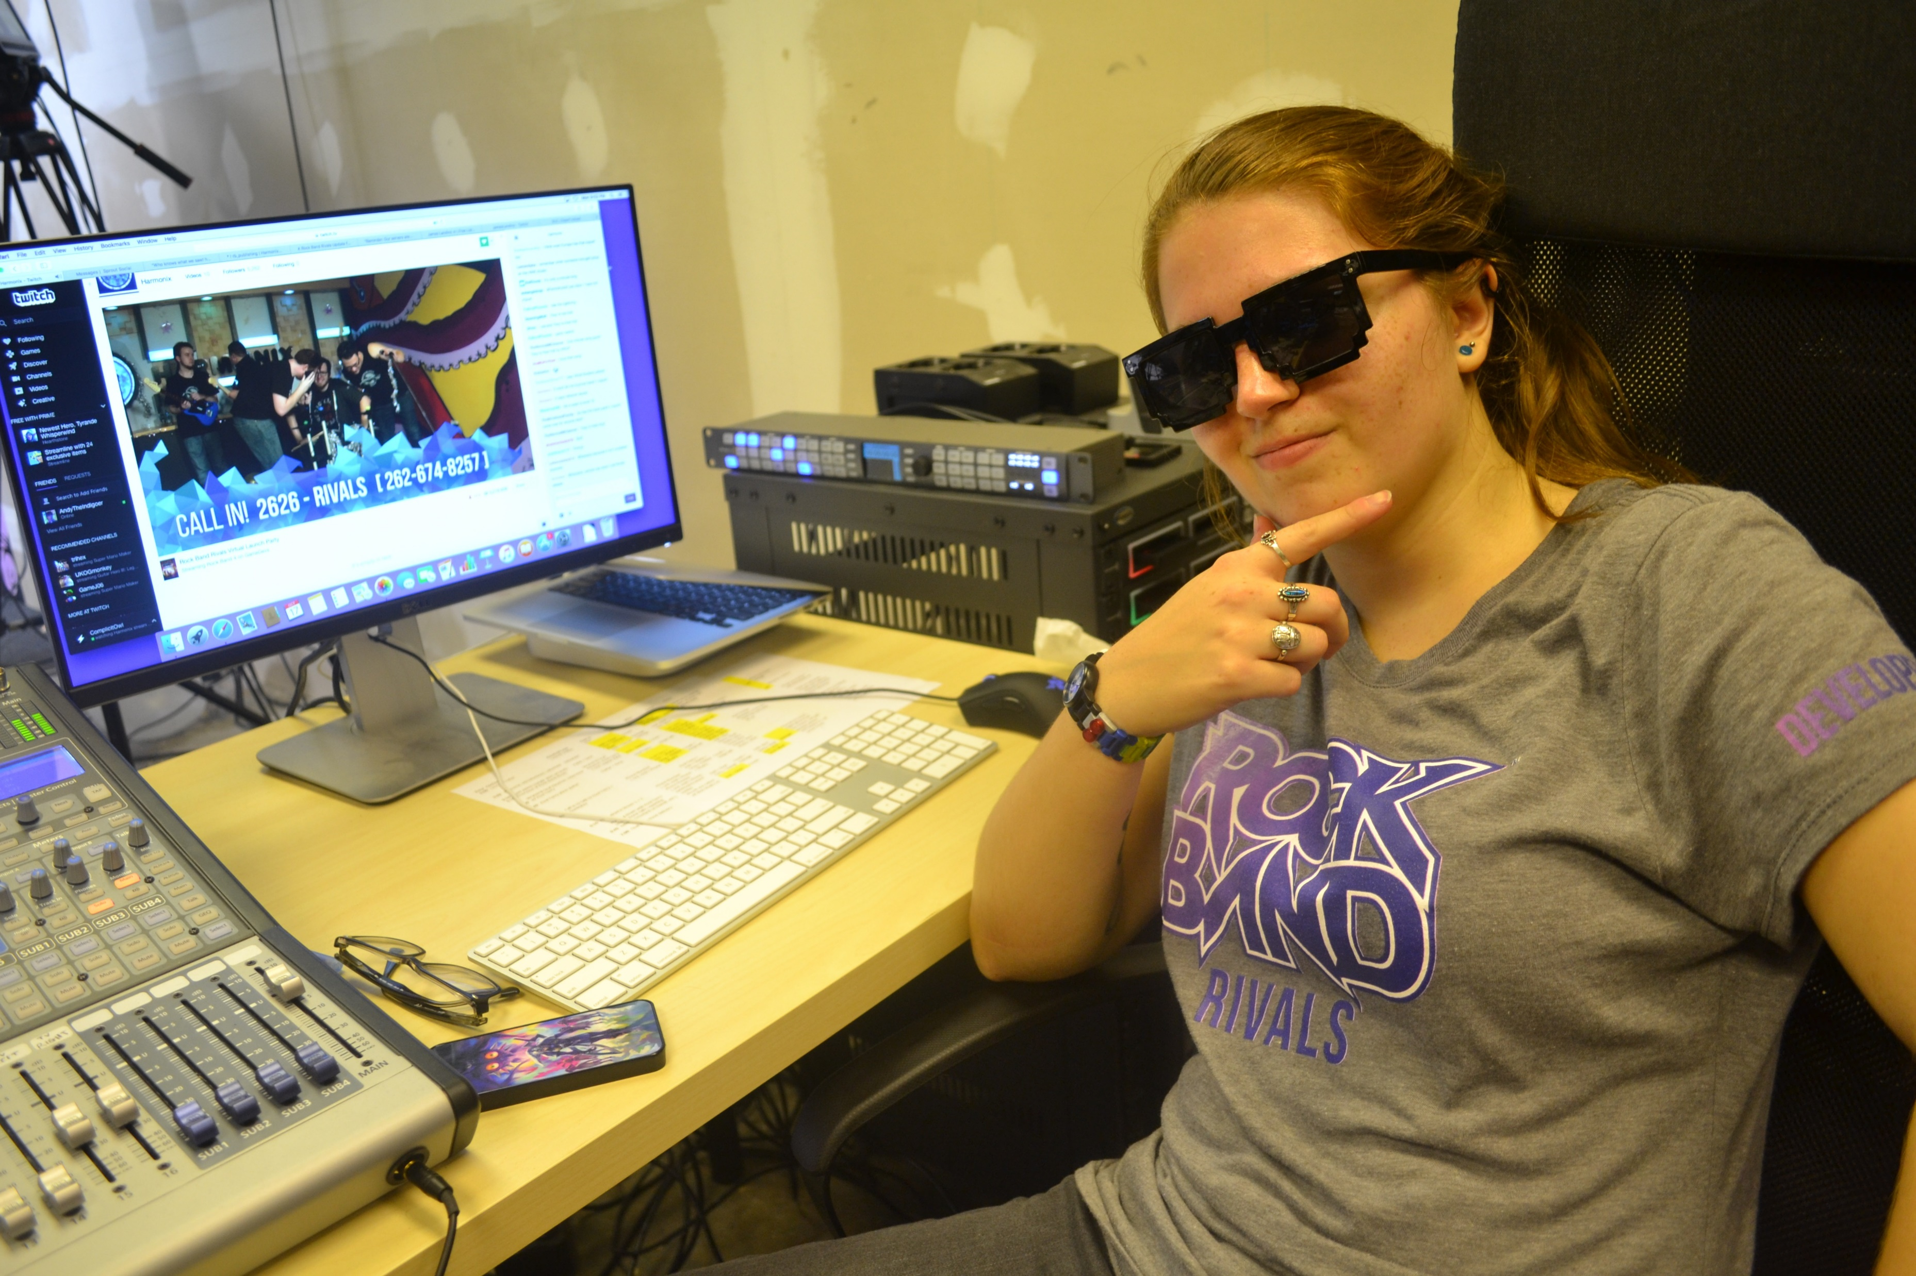

A (narrow) majority of music jobs were relevant to their non-music careers.
Relevance to non-music career.
Criss Burki
MBus, 2014
Community Relations Manager

Slide 13
When They Left Music as a Career, They…

Slide 14
How They Got Their First Non-Music-Career Job

Slide 15
Their First Non-Music-Career Job

Slide 16
Full Details at OtherBerkleeAlumni.com

Slide 17


What Berklee Did Well #1 (71; 41%)
Better Thinking
& Learning
Nicole Olver
Pro. Music, 2013
Head of Human Resources (HR)
Bill Langdon
MP&E, 2014
Broadcast Engineer

Slide 18


What Berklee Did Well #2 (58; 33%)
Focus and Drive
(Incl. Time Management Skills)
Casey Kidd
CWP, 2012
Data Analyst, Entrepreneur
Lucy Patterson
Film Scoring, 2017
IT Recruiter

Slide 19
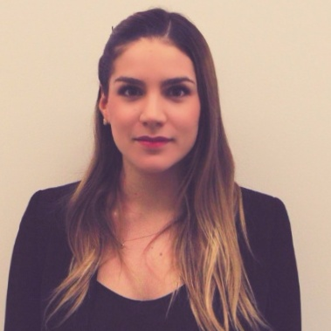
What Berklee Did Well #3 (51; 29%)
Diversity and
Collaboration
Susana Monsalve-Jones
MP&E + Film Scoring, 2013
Management Consultant
MBA

Slide 20
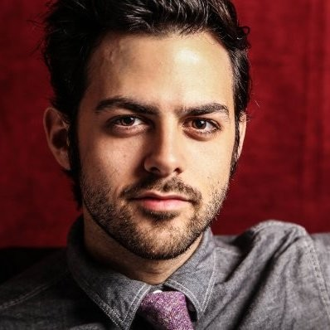
What Berklee Did Well #4 (24, 14%)
Networking Skills
Jacob Cohen
Performance, 2010
Real Estate Agent

Slide 21
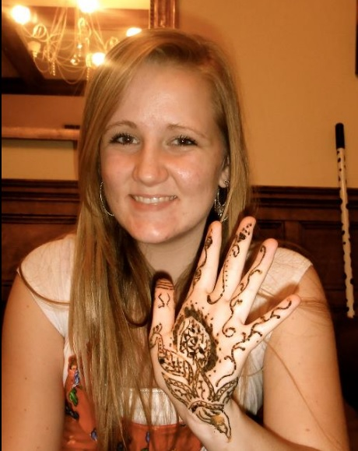
What Berklee Did Well #5 (22; 13%)
Directly-Applicable
Classes
Cambria Russell-Herrera
MBus, 2015
Art (Sculpture) Studio Manager

Slide 22

What Berklee Did Well #6 (18, 10%)
Professionalism
Julian Lenz
EPD, 2016
Account Manager

Slide 23

What Berklee Did Well #7 (17, 10%)
Business Skills
Leah Hinton
MBus, 2013
Staffing Coordinator

Slide 24
What Berklee Did Well

Slide 25
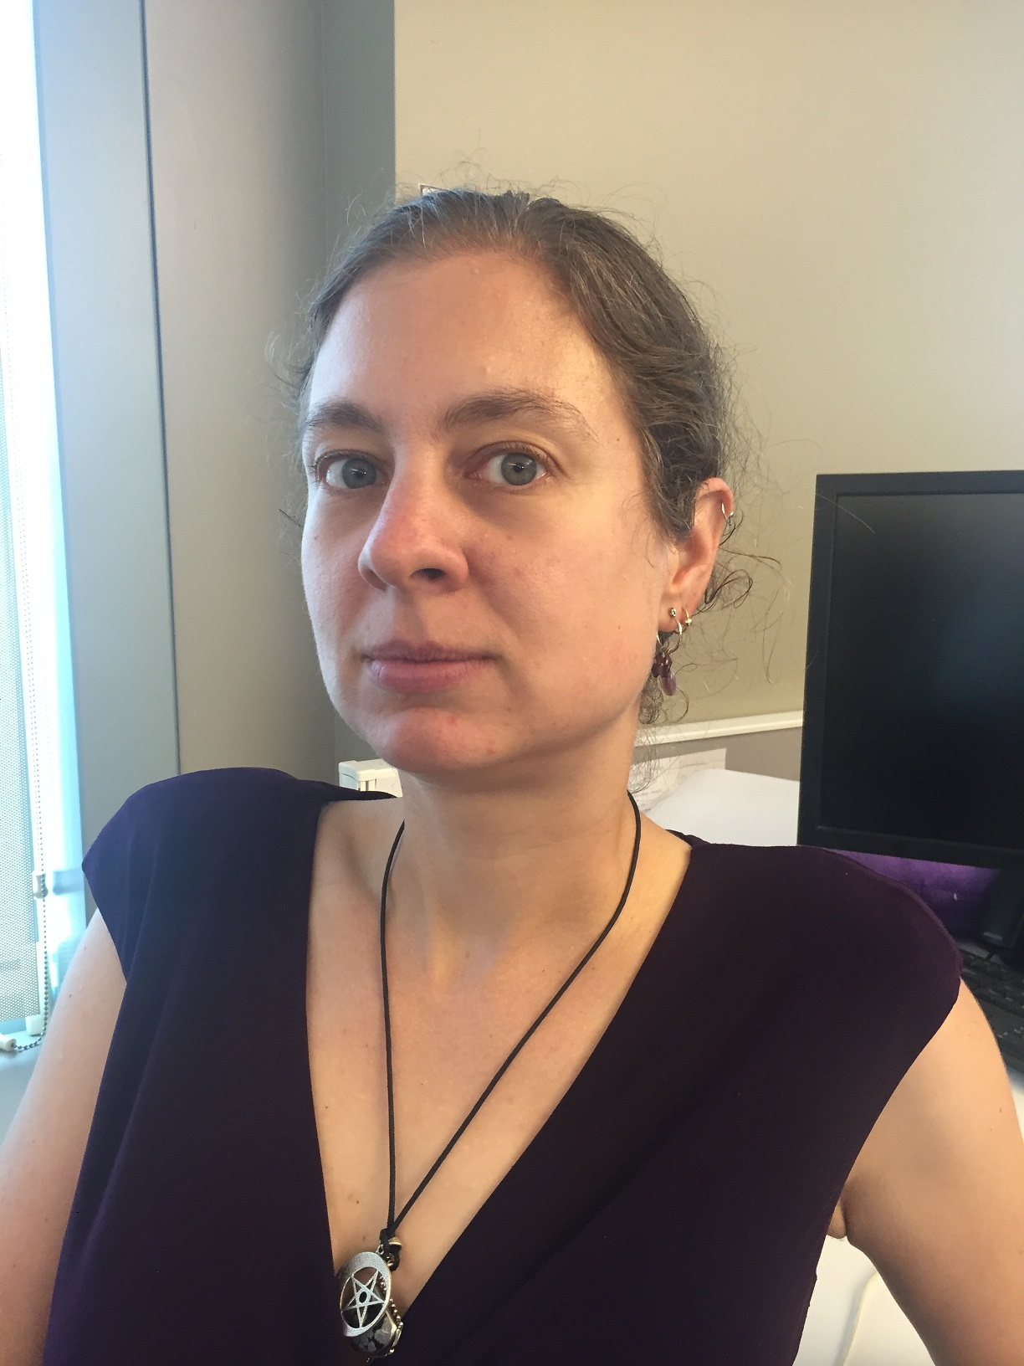

Advice for Current Students #1 (68, 39%)
Seize opportunities
and try things.
Dawn-Marie Dunn
EPD + Pro. Music, 2012
Software QA Engineer
Adam Rosenwach
Pro. Music, 2010
V.P. of Business Operations

Slide 26
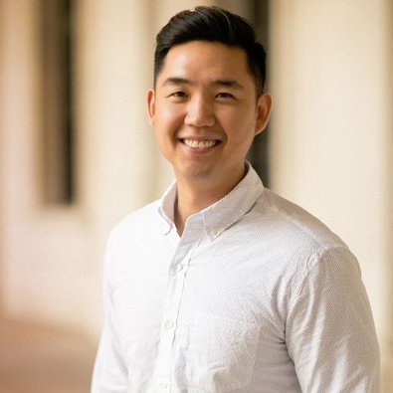

Advice for Current Students #2 (65, 37%)
It’s OK to work
outside music.
Phil Lee
MBus, 2007
Computer Support Engineer
Lauren Nedelman
Musical Theater (BoCo), 2010
Food Demo CEO/Entrepreneur

Slide 27

Advice for Current Students #3 (61, 35%)
Figure out what
you really want.
John Branch
EPD, 2010
Tech. Support Supervisor

Slide 28
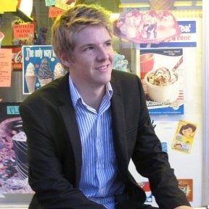
Advice for Current Students #4 (53, 30%)
Network and
research careers.
John Lahr
MBus, 2016
Dir. of Strategic Partnerships (Sales)

Slide 29
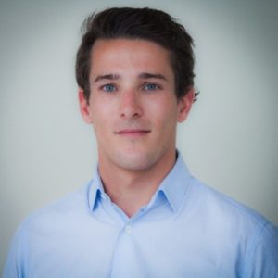
Advice for Current Students #5 (38, 22%)
Be realistic.
(And the first years can be tough.)
Stanislas Barrault,
MBus, 2013
Data Scientist
Masters of Science in Management

Slide 30
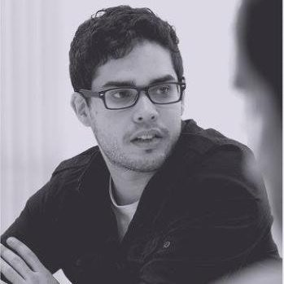
Advice for Current Students #6 (31, 18%)
Work hard.
Ricky Gonzalez,
MBus, 2011
V.P. of Content, E-Sports

Slide 31

Advice for Current Students #7 (28, 16%)
Move forward.
Alex Bercow
EPD, 2016
Customer Tech Support

Slide 32
Advice for Current Students
Also:
Be can-do. (19)
Apply your music skills. (16)
Be responsible with your money. (10)

Slide 33
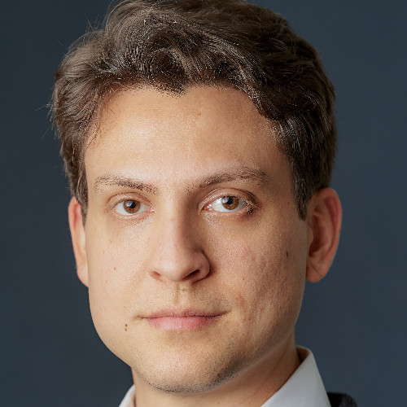
Current Relationship with Music
Henry Moyerman
MP&E + EPD, 2011
(Technical) Product Manager
Masters in Computer Science

Slide 34

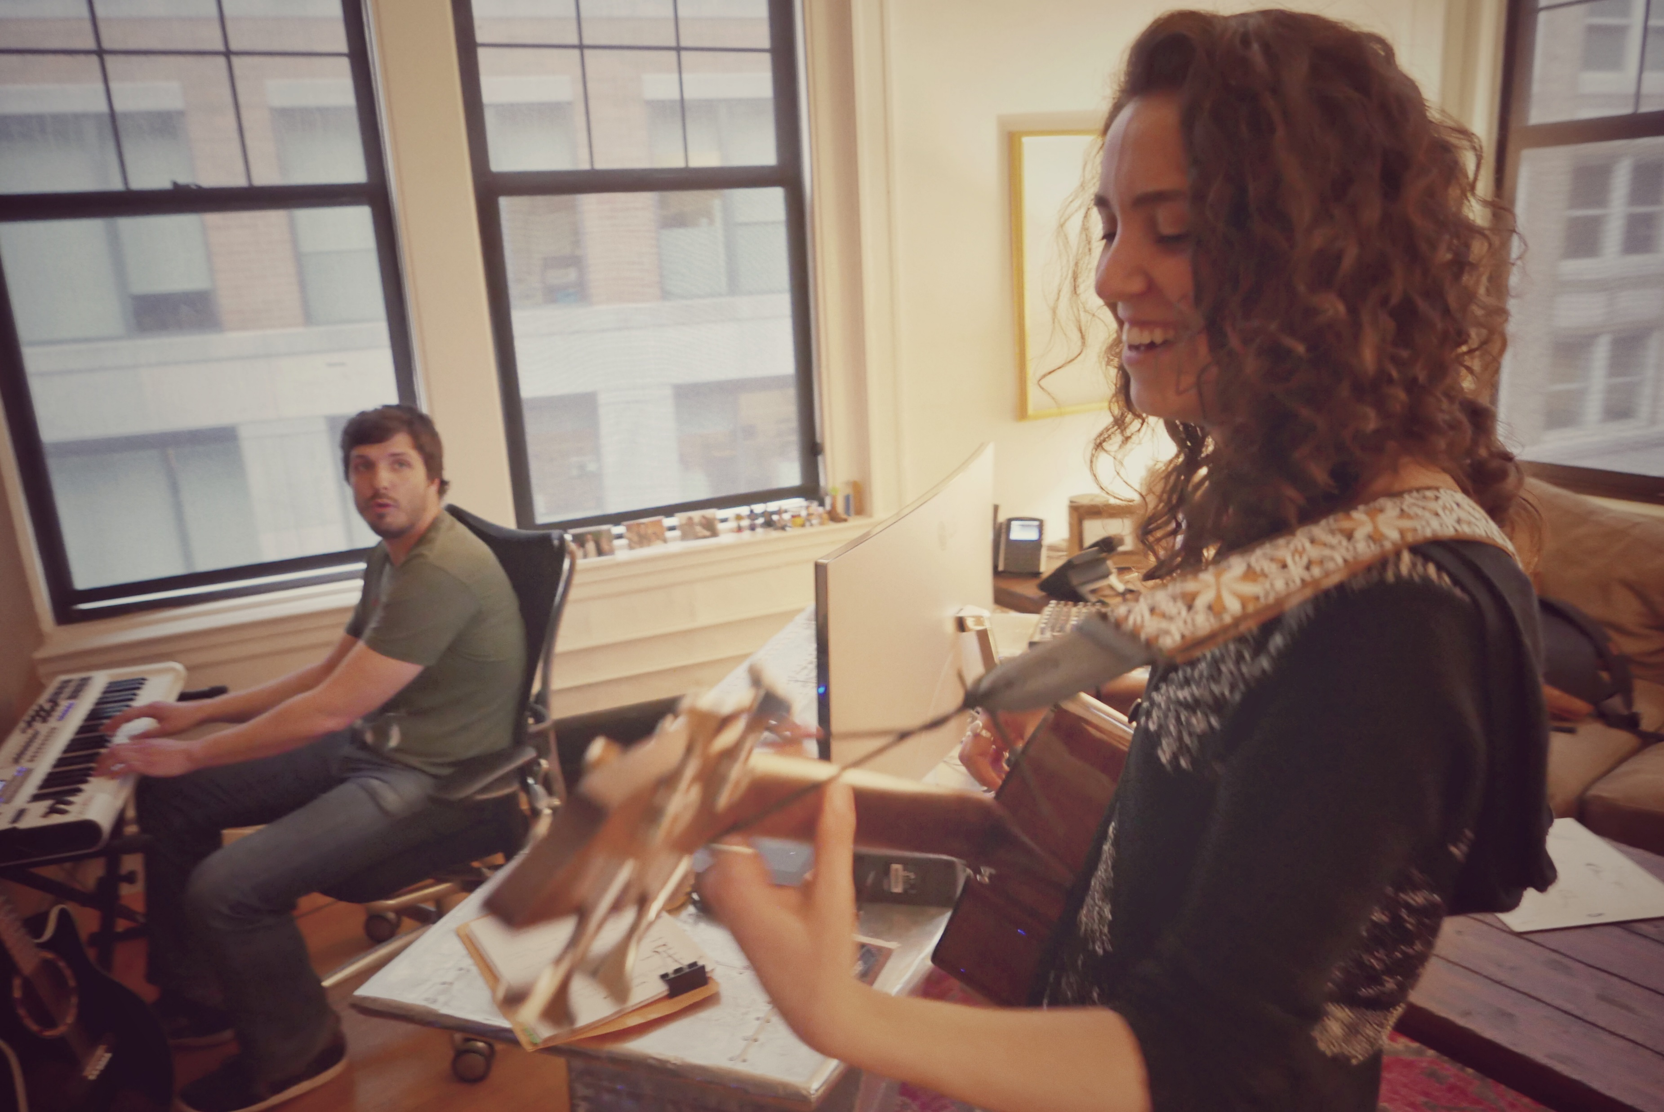
In Conclusion
What you learned at Berklee will prove useful in many fields.
Try things with an open mind; it’s perfectly OK if you end up working outside music.
Music will still be part of your life (if you want it to be), regardless of your profession.
The Career Center is your friend!
Amy Puffer; MP&E 2016; Video Post-Production Asst.

Slide 35
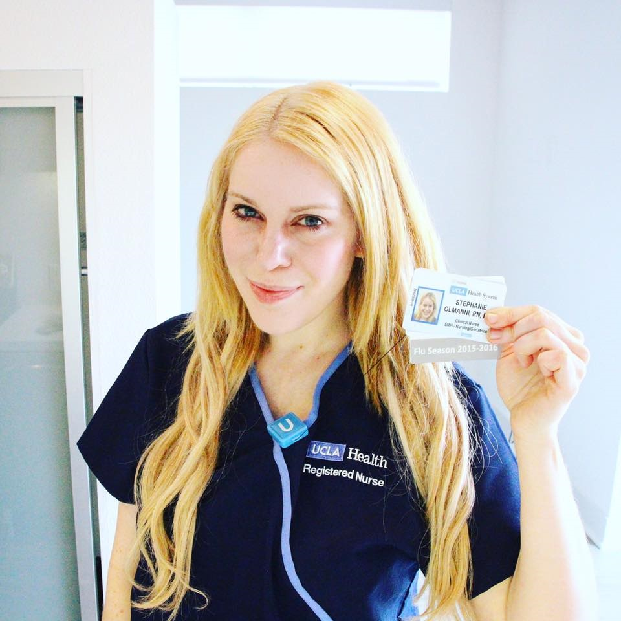
Last Words
Stephanie Olmanni
Film Scoring + EPD, 2008
Registered Nurse
B.S. in Nursing

Slide 36
Thank you!
Don’t forget to check out OtherBerkleeAlumni.com
Any questions?

Slide 37
No, really.
We’re done here.

Slide 38
OK I lied. A few extra slides:

Slide 39
Majors

Slide 40
Principal Instrument / Gender

Slide 41
Where They Are

Slide 42

Advice for Current Students #8 (20, 13%)
Be can-do.
Jared Winegrad,
MBus, 2013
Venture Capital Fund Principal

Slide 43
OK, now that’s all I got.
Over and out.

