Slide 1
Berklee Alumni Working Outside of Music: Paths, Thoughts, and Advice
Prof. Kevin Block-Schwenk
Liberal Arts (Economics & Math)

Slide 2
The Project: Interviewing relatively-recent Berklee alumni with good non-music careers.
Criteria to qualify:
Under 25% of their job is music-related.
Graduated from Berklee within a decade.
Berklee was their first Bachelors Degree.
On track to earn at least $45,000 this year.
At their job for at least 6 months.
Like their field and expect to continue working in it for years.

Slide 3
The Project: Interviewing relatively-recent Berklee alumni with good non-music careers.
Criteria to qualify:
Under 25% of their job is music-related.
Graduated from Berklee within a decade.
Berklee was their first Bachelors Degree.
On track to earn at least $45,000 this year.
At their job for at least 6 months.
Like their field and expect to continue working in it for years.
Three topics:
Describing their current job.
Recounting their path from Berklee to what they do now.
Sharing thoughts and advice.

Slide 4
The Project: Interviewing relatively-recent Berklee alumni with good non-music careers.
Criteria to qualify:
Under 25% of their job is music-related.
Graduated from Berklee within a decade.
Berklee was their first Bachelors Degree.
On track to earn at least $45,000 this year.
At their job for at least 6 months.
Like their field and expect to continue working in it for years.
Three topics:
Describing their current job.
Recounting their path from Berklee to what they do now.
Sharing thoughts and advice.
150 interviews done as of mid-September, 2018.

Slide 5
The Project: Interviewing relatively-recent Berklee alumni with good non-music careers.
Criteria to qualify:
Under 25% of their job is music-related.
Graduated from Berklee within a decade.
Berklee was their first Bachelors Degree.
On track to earn at least $45,000 this year.
At their job for at least 6 months.
Like their field and expect to continue working in it for years.
Three topics:
Describing their current job.
Recounting their path from Berklee to what they do now.
Sharing thoughts and advice.
150 interviews done as of mid-September, 2018.
All interviews can be seen at OtherBerkleeAlumni.com.

Slide 6
Majors

Slide 7
Year of Graduation

Slide 8
What They’re Doing Now

Slide 9
What They’re Doing Now -- Broken out by Berklee Major
MBus + Pro.
MP&E, EPD, CWP
Other

Slide 10
Additional Degrees

Slide 11
Years Until Their Non-Music Career Started

Slide 12
…Excluding Time as a Full-Time Student

Slide 13
Years working in Music

Slide 14
When They Left Music as a Career, They…

Slide 15
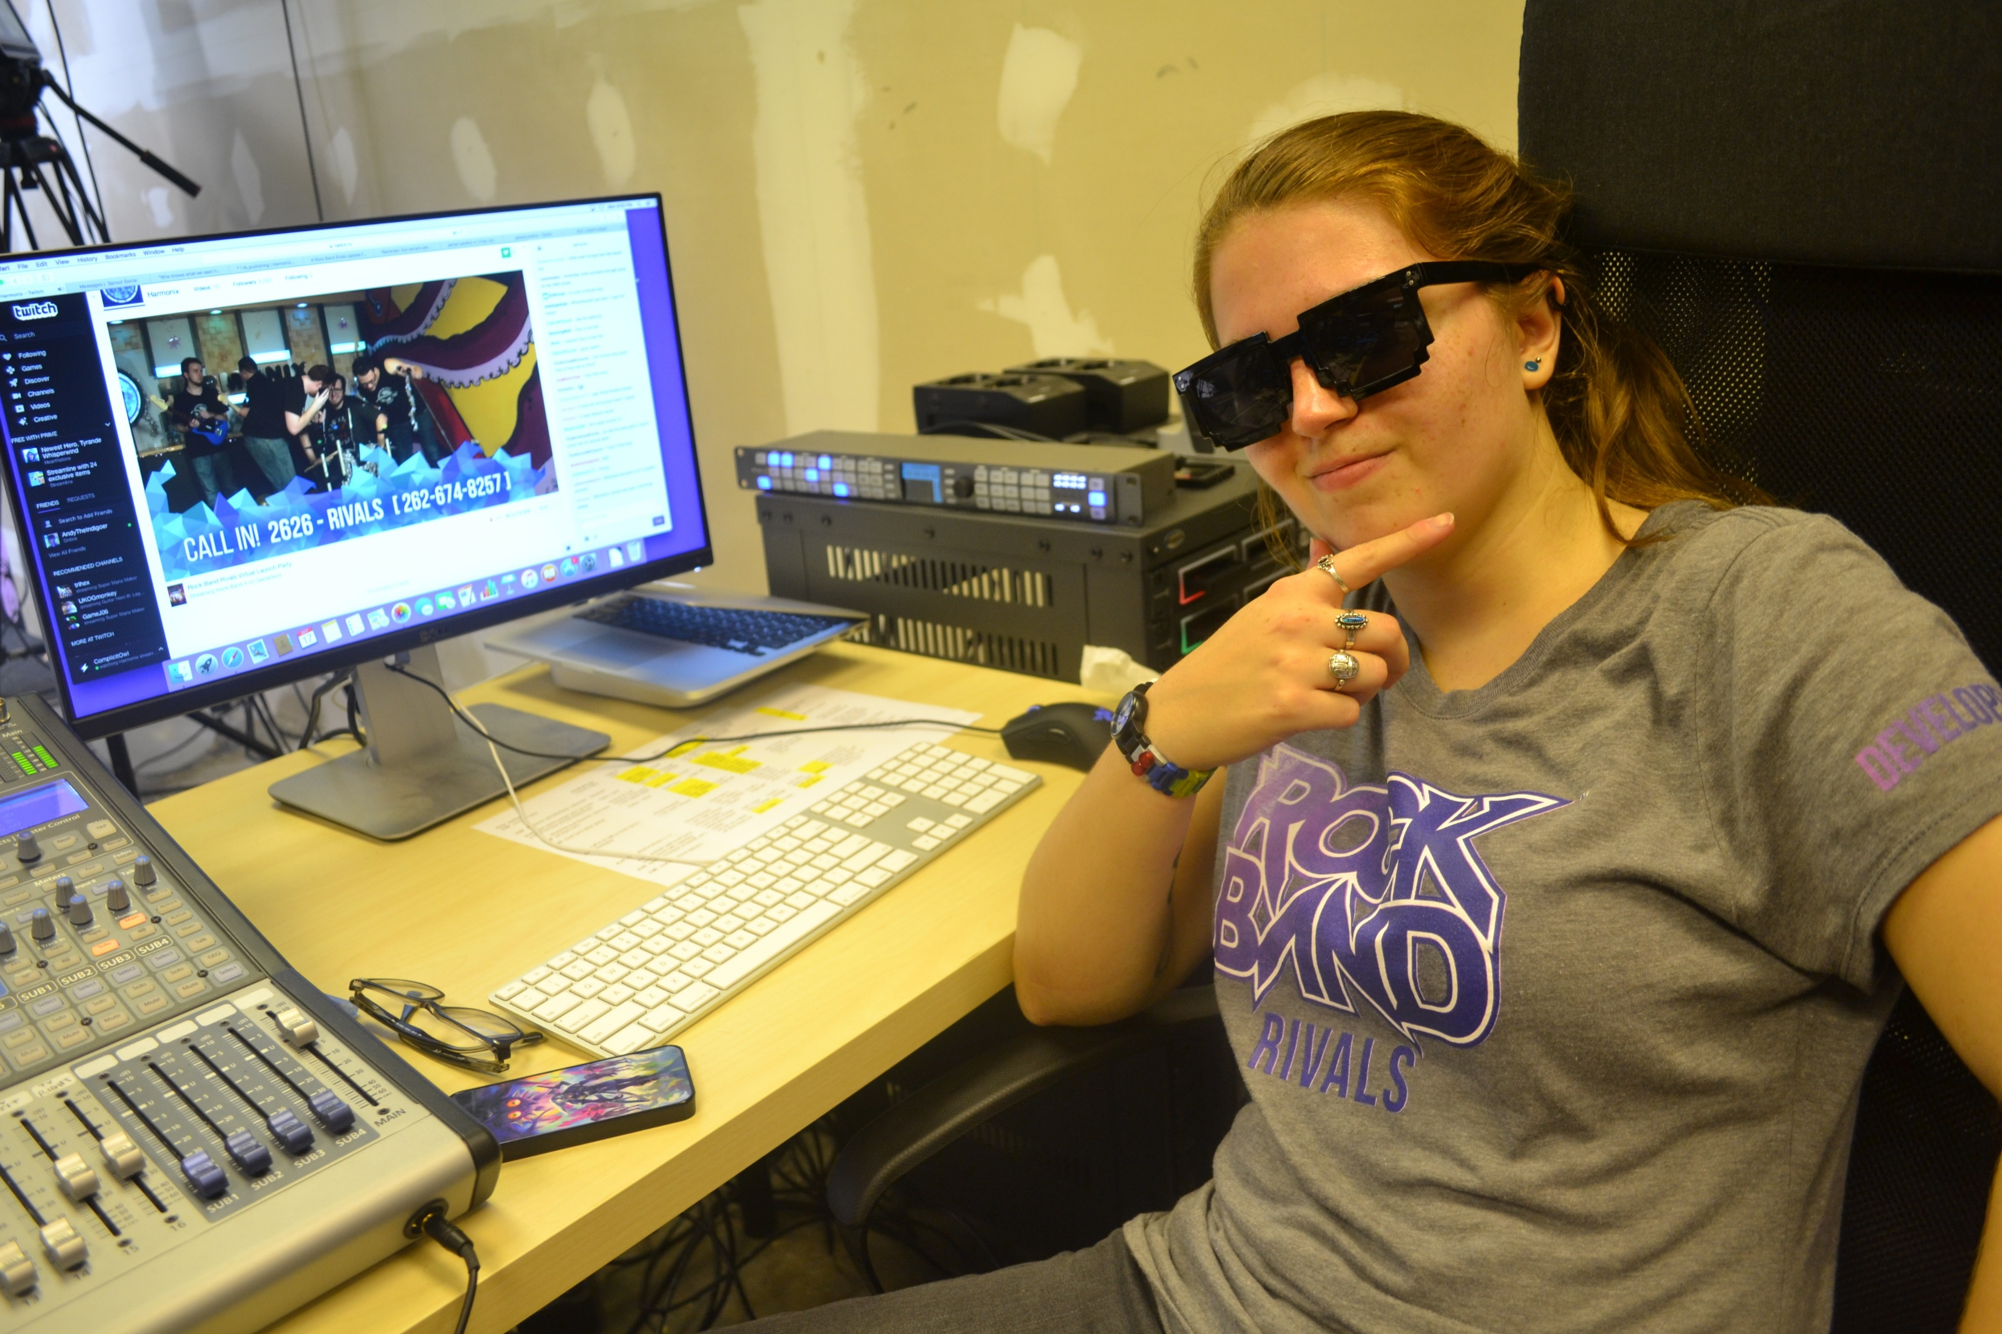
A (narrow) majority of music jobs were relevant to their non-music careers.
Relevance to non-music career.
Criss Burki
MBus, 2014
Community Relations Manager

Slide 16
How They Got Their First Non-Music-Career Job

Slide 17
Their First Non-Music-Career Job

Slide 18
Full Details at OtherBerkleeAlumni.com

Slide 19
What Berklee Did Well #1 (61; 41%)
Better Thinking
& Learning
Nicole Olver
Pro. Music, 2013
Head of Human Resources (HR)
Bill Langdon
MP&E, 2014
Broadcast Engineer

Slide 20
What Berklee Did Well #2 (50; 33%)
Focus and Drive
(Incl. Time Management Skills)
Casey Kidd
CWP, 2012
Data Analyst, Entrepreneur
Lucy Patterson
Film Scoring, 2017
IT Recruiter

Slide 21
What Berklee Did Well #3 (43; 29%)
Diversity and
Collaboration
Susana Monsalve-Jones
MP&E + Film Scoring, 2013
Management Consultant
MBA

Slide 22
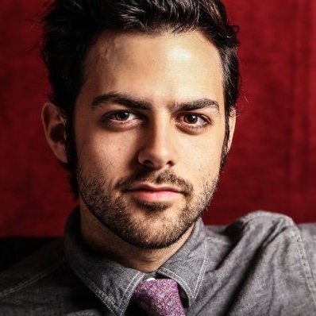
What Berklee Did Well #4 (21, 14%)
Networking Skills
Jacob Cohen
Performance, 2010
Real Estate Agent

Slide 23
What Berklee Did Well #5 (19; 13%)
Directly-Applicable
Classes
Cambria Russell-Herrera
MBus, 2015
Art (Sculpture) Studio Manager

Slide 24
What Berklee Did Well #6 (17, 11%)
Professionalism
Julian Lenz
EPD, 2016
Account Manager

Slide 25
What Berklee Did Well #7 (16, 11%)
Business Skills
Leah Hinton
MBus, 2013
Staffing Coordinator

Slide 26
What Berklee Did Well

Slide 27
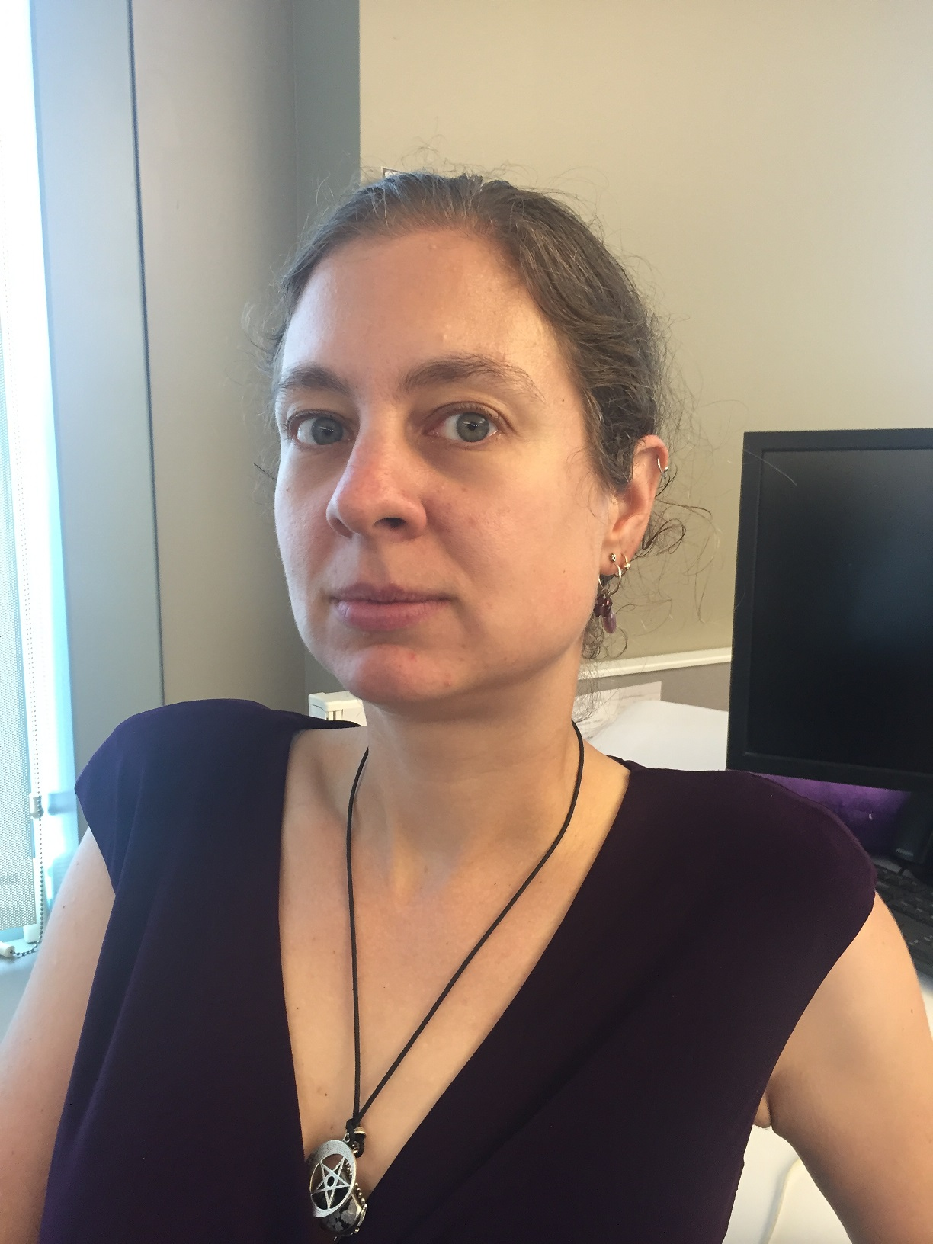
Advice for Current Students #1 (61, 41%)
Seize opportunities
and try things.
Dawn-Marie Dunn
EPD + Pro. Music, 2012
Software QA Engineer

Slide 28
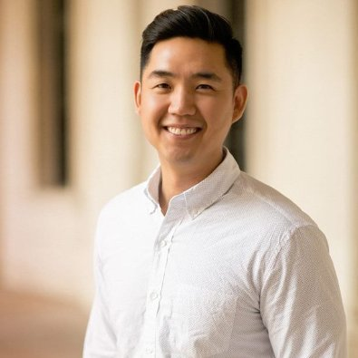
Advice for Current Students #2 (55, 37%)
It’s OK to work
outside music.
Phil Lee,
MBus, 2007
Computer Support Engineer

Slide 29
Advice for Current Students #3 (49, 33%)
Figure out what
you really want.
John Branch
EPD, 2010
Tech. Support Supervisor

Slide 30
Advice for Current Students #4 (46, 31%)
Network and
research careers.
John Lahr
MBus, 2016
Dir. of Strategic Partnerships (Sales)

Slide 31
Advice for Current Students #5 (34, 23%)
Be realistic.
(And the first years can be tough.)
Claudia Caliano,
MBus, 2009
Corporate Trainer Consultant

Slide 32
Advice for Current Students #6 (28, 19%)
Work hard.
Morgan Mallory,
MBus, 2012
Office Equipment Sales

Slide 33
Advice for Current Students #7 (27, 18%)
Move forward.
Alex Bercow
EPD, 2016 Customer Tech Support

Slide 34
Advice for Current Students #8 (19, 13%)
Be can-do.
Jared Winegrad,
MBus, 2013
Venture Capital Fund Principal

Slide 35
Advice for Current Students
Also:
Apply your music skills. (15)
Be responsible with your money. (10)

Slide 36
Current Relationship with Music
Henry Moyerman
MP&E + EPD, 2011
(Technical) Product Manager
Masters in Computer Science

Slide 37
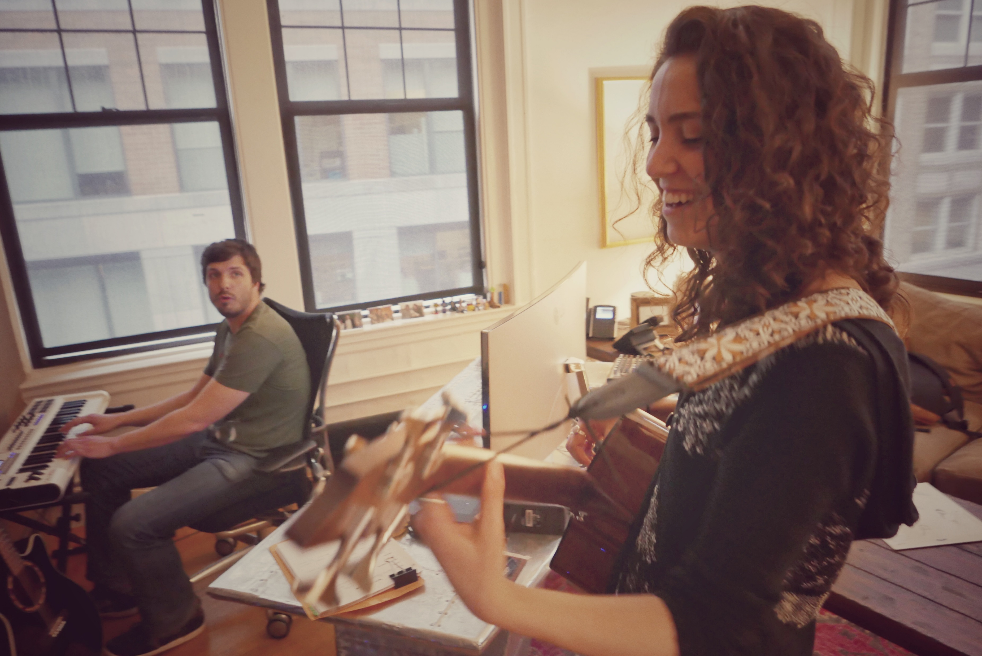
In Conclusion
What you learned at Berklee will prove useful in many fields.
Try things with an open mind; it’s perfectly OK if you end up working outside music.
Music will still be part of your life (if you want it to be), regardless of your profession.
Amy Puffer; MP&E 2016; Video Post-Production Asst.

Slide 38
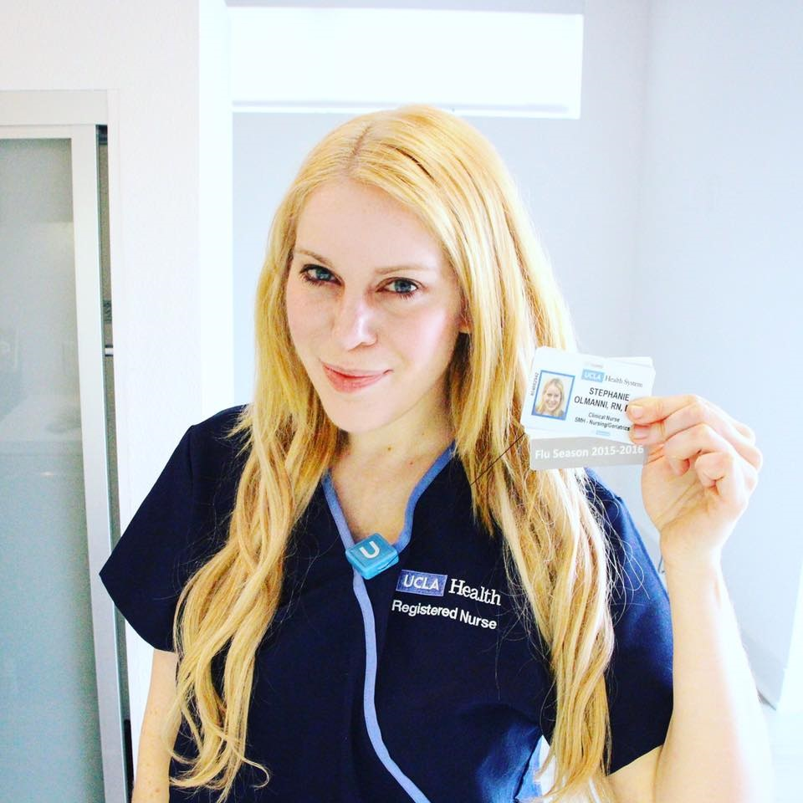
Last Words
Stephanie Olmanni
Film Scoring + EPD, 2008
Registered Nurse
B.S. in Nursing

Slide 39
Thank you!
Don’t forget to check out OtherBerkleeAlumni.com
Any questions?

Slide 40
No, really.
We’re done here.

Slide 41
OK I lied. A few extra slides:
“Business” = MBus + Pro
“Tech” = MP&E, EPD, CWP
“Other” = everything else,
including BoCo

Slide 42
Principal Instrument / Gender

Slide 43
Where They Are

Slide 44
OK, now that’s all I got.
Over and out.

